Slide 1
SMART FARMING
Meghna Lohani 16BCE1395
Aman Sharma 16BCE1224
KOTHURI SAI PHANINDRA 16BCE1075

Slide 2
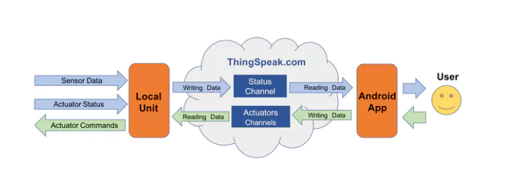
Logical Design

Slide 3
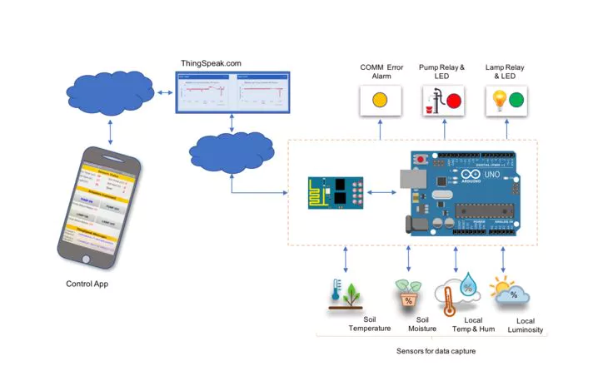
Physical Design

Slide 4
IOT Level 5
Several nodes
Actuators and sensors separately (Observers)
1 coordinator (Gateway) –WSN-based
Complex data analysis: different sensors
Cloud analysis
Reports collected
measurements and state/status to the cloud
Cloud storage

Slide 5
Abstract
Our goal will be to basically collect information from a local unit and send it to the internet. A user anywhere on the planet looking at this information will make decisions by sending remote commands to the actuators, which will also be in this local unit. Actuators can also turn on/off automatically based on the sensor data.
The data to be collected by sensors will be:
Air Temperature and relative humidity
Soil Temperature and humidity
Luminosity

Slide 6
The project will have 2 actuators:
Electrical Pump
Electrical Lamp
The status of those actuators ("ON/OFF"), should be also sent to the cloud.
So, the idea will be to capture those data from the sensors, for example, a plantation and send them to cloud. Based on those data, the actuator will take the decision based on those statements:
Turn ON the Pump if the soil humidity is too low
Turn ON the Lamp if the soil temperature is too low
We can also remotely command our actuators using the Android App.

Slide 7
Protocol used
TCP/IP
Data will be sent from sensors to cloud using TCP.

Slide 8
Communication API : ThingSpeak
ThingSpeak is an IoT analytics platform service that allows you to aggregate, visualize and analyze live data streams in the cloud. ThingSpeak provides instant visualizations of data posted by your devices to ThingSpeak. With the ability to execute MATLAB code in ThingSpeak you can perform online analysis and processing of the data as it comes in. ThingSpeak is often used for prototyping and proof of concept IoT systems that require analytics.

Slide 9
Components Needed
1 x 2 Channel DC 5V Relay Module with Optocoupler Low Level Trigger -
5V DC Pump -
220V Lamp
2 x 330 ohm resistor (to be used with LEDs)
2 x 10K ohm resistor (to be used with DHT22 and LDR)
1 x 4K7 ohm resistor (to be used with DS18B20
Protoboard
Jumpers
External 5V DC Power for Relays
Arduino UNO (Microcontroller)
ESP8266-01 (Communication Module) -
DHT22 (Air and Relative Humidity Sensor) -
DS18B20 (1-Wire Digital Temperature sensor for use on soil)
YL-69 + LM393 (Soil Humidity sensor) -
LDR (Luminosity Sensor) -
2 x LEDs (Red and Green)

Slide 10
Workflow
Installing sensors and ESP-01
Configuring ThingSpeak channel
Sending status to the cloud using status channels.
Basic app for data monitoring.
Installing actuators.
Configuring ThingSpeak actuator channel.
Sending command to actuators based on conditions.
Completing the app.

Slide 11
Cost
Rs. 2500 approx

Slide 12
Thank You!

